Slide 1
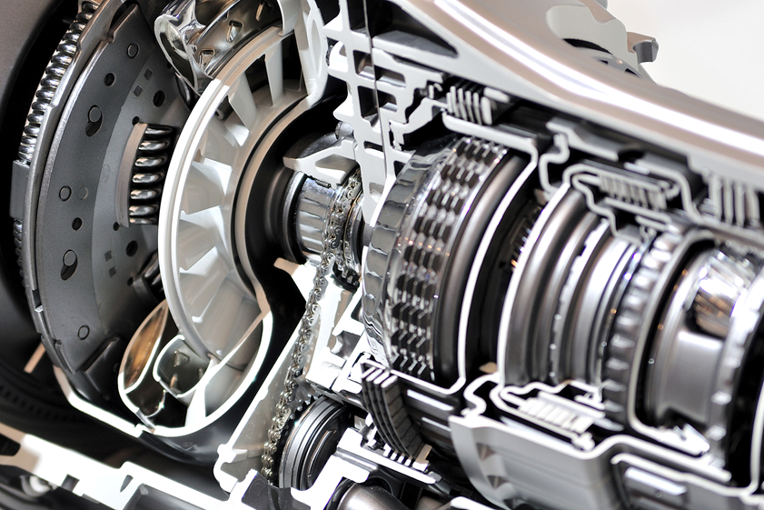
The clutch

Slide 2
Before reading the text
фрикционное устройство
friction device —
pressure disc —
to connect — hard-wearing material –
gearbox —
frictional force — to start the car —
clutch pedal —
нажимной диск
соединять
износостойкий материал
коробка передач
сила трения
завести автомобиль
педаль сцепления

Slide 3
…Still before reading
отсоединить двигатель
to release the engine —
at rest —
is engaged —
to fix —
flywheel —
is disengaged —
friction disc (plate) —
to run idly —
в покое
включено(подсоединено)
крепить (устанавливать)
маховик
отключено
фрикционный диск
работать вхолостую

Slide 5
Translate the words
connect — disconnect — connection — disconnection
operate — operation
friction — frictional
engage — engagement — disengagement

Slide 6
Read and translate
start
friction
material
disc
frictional
control
base
principal
pedal

Slide 7
Text
The clutch is a friction device. It connects the engine to the gears in the gearbox. It is used for disconnecting the engine from the gearbox, for starting the car and for releasing the engine from the car wheels. The clutch is fixed between the flywheel of the engine and the gearbox und consists of two plates (discs): the friction disc and the pressure disc. The friction disc is situated between the flywheel and the pressure plate and has a hard-wearing material on each side.The basic principal operation of the clutch is a frictional force acting between two discs. The clutch is controlled by the clutch pedal. When the pedal is at rest the clutch is engaged and the running engine is connected to the gearbox. When the pedal is pressed down the clutch is disengaged and the engine runs idly.

Slide 8
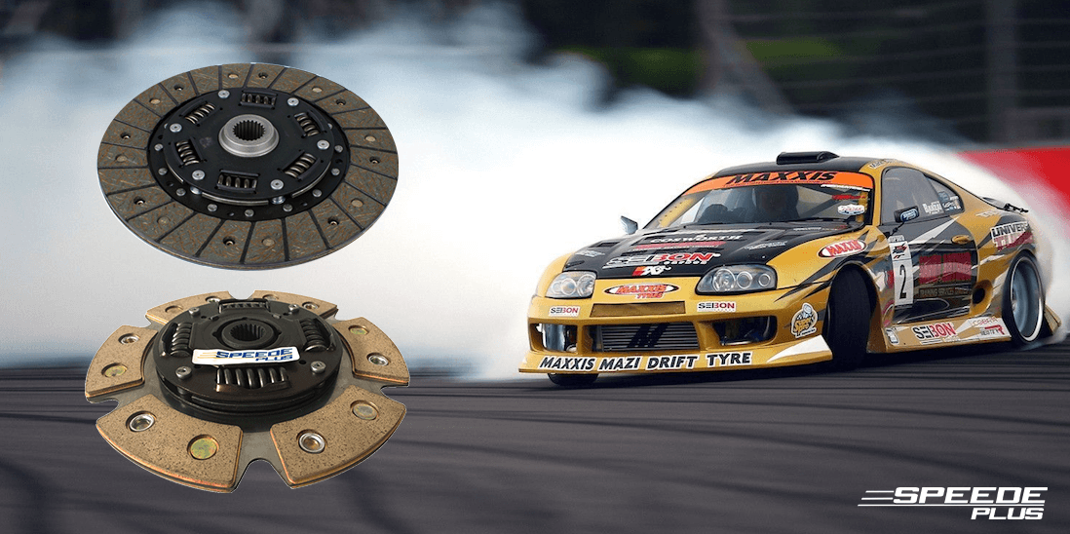
After reading
Find in text and translate to Russian.
Friction device, clutch, gearbox, to free, to start, to release, flywheel, pressure plate, basic principle of operation, to fix, hard-wearing material, to consist of, to be controlled by, running engine, to run idly, to engage, to disengage, to press down, to be at rest.
Well done ;)

Slide 9
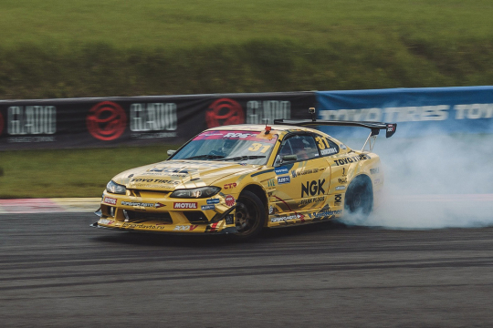
After reading
Find in the text the answers to the following questions.
1.What device is the clutch?
2.What units does it connect?
3.What is the clutch used for?
4.Where is the clutch placed?
5.What plates does the clutch consist of?
6.What is the basic principal operation of the clutch?
7.What is the clutch controlled by?
8.What takes place when the clutch pedal is at rest?
9.When does the engine run idly?

Slide 10
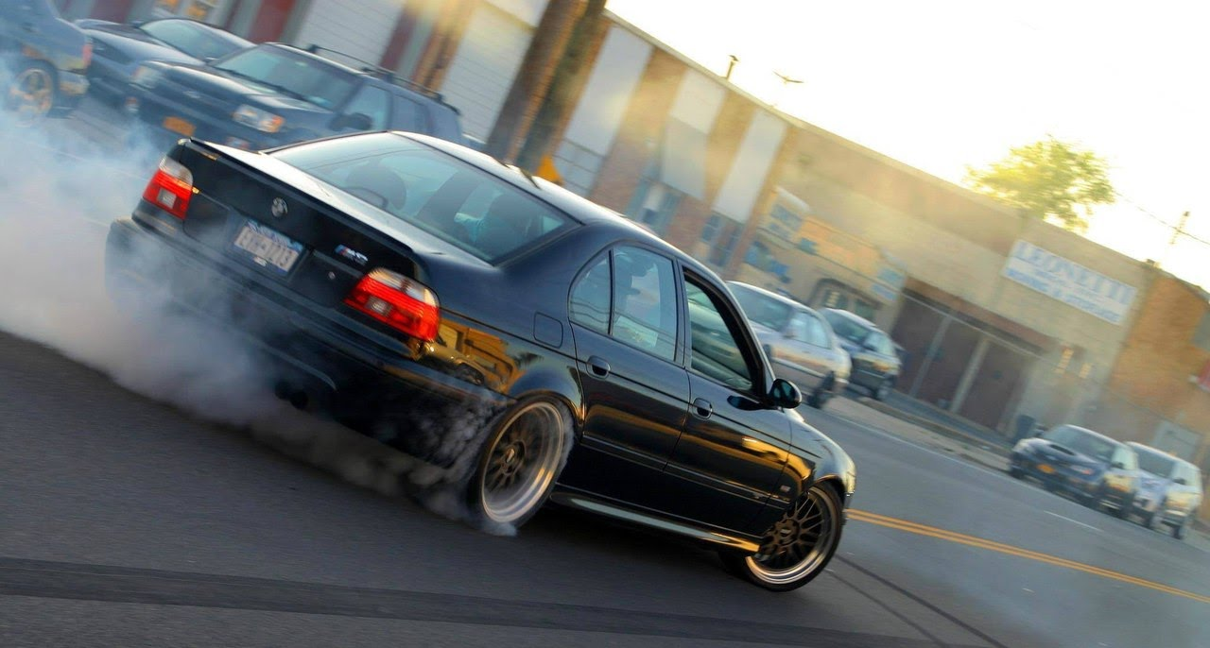
Complete the sentences
1. The clutch is a device connecting ....
a).the rear axle and axle shafts.
b).the gearbox and the differential.
c).the engine and the gearbox.
2.The clutch is situated between ....
a).the gearbox and cardan shaft.
b).the flywheel and the gearbox.
c).the gearbox and rear axle.
3.The clutch is controlled by ....
a). the brake pedal
b). the clutch pedal.
c).the gearbox and rear axle.
4.The clutch is engaged ....
a).when the clutch pedal is pressed down.
b).when the clutch pedal is at rest.
5.The clutch is disengaged ....
a).when the clutch pedal is at rest.
b).when the clutch pedal is pressed down.

Slide 11
Match the words
a friction device
gearbox
to start the car
to release the engine
is fixed
flywheel
the friction disc
the pressure disc
hard-wearing material
frictional force
the clutch pedal
to be engaged
to be at rest
to be disengaged
to press down on the pedal
to run idly
Завести автомобиль
Фрикционный диск
Маховик
Износостойкий материал
Работать вхолостую
Соединяться
Сила трения
Разъединяться
Фрикционное устройство
Находиться в покое
Закреплен
Педаль сцепления
Нажать на педаль
Отсоединить двигатель
Нажимной диск
Коробка передач

Slide 12
Good job☺

Slide 13
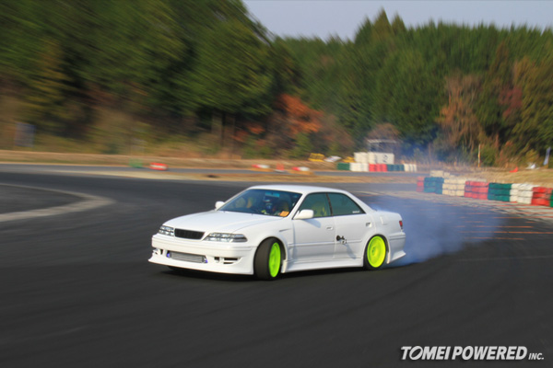
Complete the sentences
A. :What three functions does the clutch ... ?
B. :It is used for ....
A. :Where is it... ?
B. :It is ... between the flywheel of the engine and the ....
A. :By what is the clutch ... ?
B. :It is ...by the....
A. :What takes place when the pedal is ... ?
B. : The clutch is ....
A. : And when the driver pushes down on the pedal?
B. : The clutch is ....
freeing the engine from the gearbox, serve, fixed, gearbox, controlled, starting the car, freeing the engine from the car wheels, pedal, at rest, engaged, disengaged, do, located.

Slide 14
Translate into English
Сцепление — это фрикционное устройство.
Сцепление соединяет двигатель и коробку передач.
Сцепление расположено между маховиком двигателя и коробкой передач.
Как правило, сцепление состоит из двух дисков: ведомого и нажимного.
Сцепление управляется педалью сцепления.
Когда педаль сцепления находится в покое, диски сцепления соединены и работающий двигатель соединен с коробкой передач и колесами.
Когда водитель нажимает на педаль сцепления, диски отходят, сцепление отсоединятся и двигатель работает вхолостую.

Slide 15
vocabulary
friction plate (disc) - фрикционный (ведомый) диск (сцепления)
frictional force — сила трения
gear — шестерня; передача
gearbox — коробка передач
hard-wearing material — износостойкий материал
press down the pedal - нажимать на педаль
pressure plate (disc) - нажимной диск(сцепления)
principle of operation — принцип действия
release – отпускать
run idly- работать вхолостую
running engine — работающий двигатель
be at rest — быть в исходном положении (в покое)
car wheels - колеса автомобиля
clutch - сцепление
clutch pedal — педаль сцепления
connect — соединять
control — управлять
disconnect – отсоединять
disengage - отключать
engage — включать
fix — фиксировать, устанавливать
flywheel — маховик

