Slide 1
Complete please, Seasons and months
Spring:……….April,……..
……: September,….,……..
Summer: …..,……,August
…….: December,…..,……

Slide 2
What is the weather like in?
In winter it’s .………….
In spring it’s ……….
In summer it’s…….
In autumn it’s……

Slide 3
match
Pick
Go
Read
Play
Rake
Swimming, snowballs, books, leaves, flowers.
Watch
Go
Have
Make
Rake
a picnic, a snowman, leaves, skiing, TV.

Slide 4
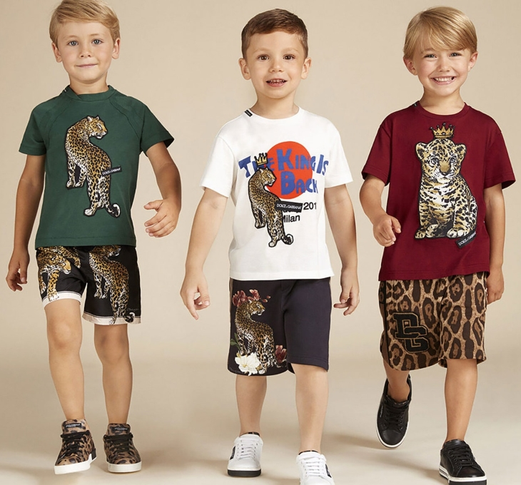
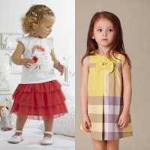
The boy is wearing…. The girl is wearing……

Slide 5
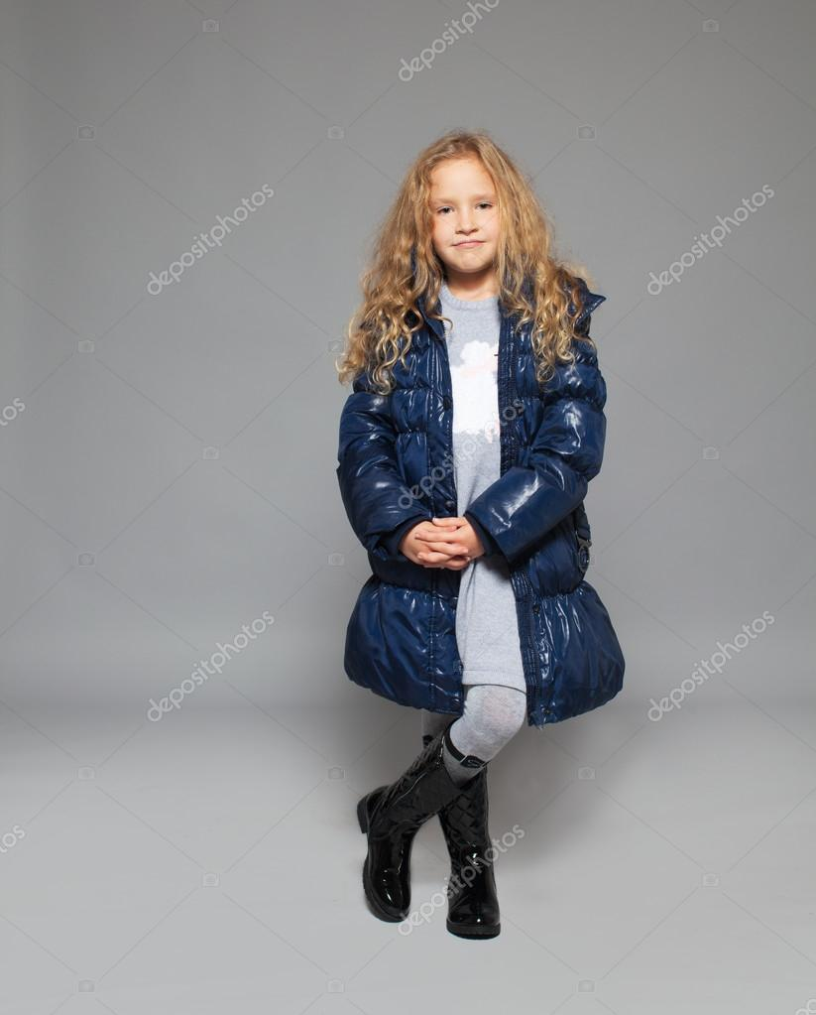
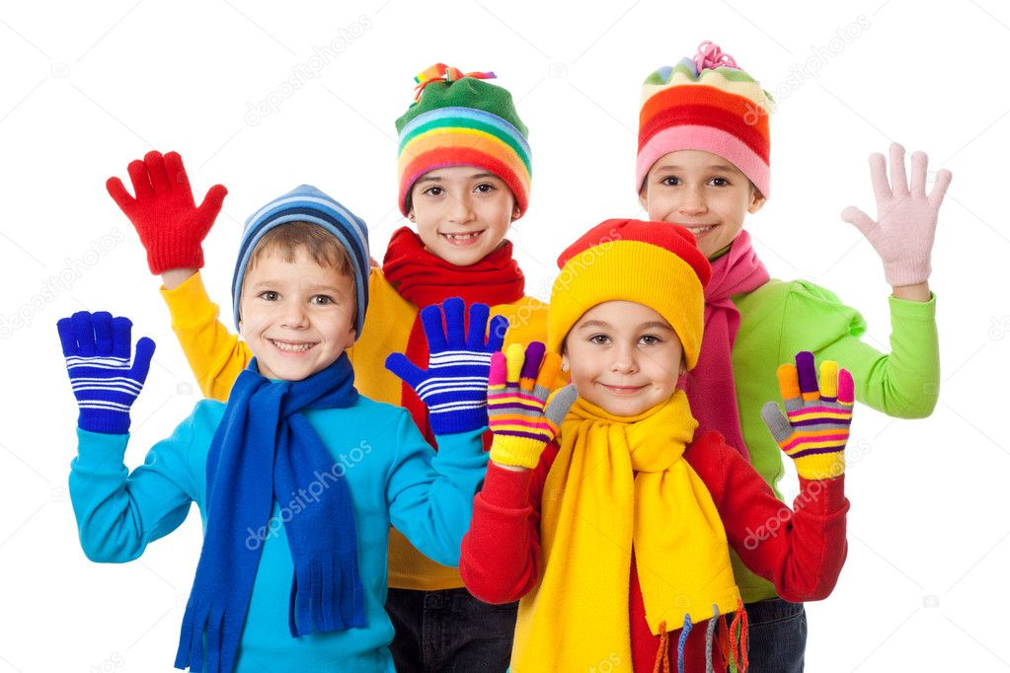
The boy is wearing…. The girl is wearing……

Slide 6
Finish the sentences
It’s cold and rainy.
Put on…….
It’s warm and cloudy.
Put on……
It’s hot and sunny.
Put on…..
It’s cold and rainy.
Put on…….

Slide 7
Present simple or present continuous?
1.She (cook) every day.
2.She (cook) now.
3. We always(play) tennis.
4. We (play) now.
5.He (read)a book now.
6. He often (read) books.
7.I (watch)TV now.
1.He (swim) every day.
2.He (swim) now.
3. They always(play) football.
4. They (play) now.
5.She (help)her mum now.
6. She often (help)her mum.
7.I (water)flowers now.

